Slide 1
SEQUENTIAL CIRCUIT DESIGN
EXAMPLE 1 using D Flip Flop
LECTURE 8

Slide 2
STEPS FOR SEQUENTIAL CIRCUIT DESIGN
State Diagram
State Reduction And Assignment
Next State Table
Flip Flop Transition Table (FLIP FLOP Selection)
Simplification
Input/output Equations
Implementations of Equation(Logic Diagram)

Slide 3
STATE DIAGRAM
00
11
01
10

Slide 4




STATE DIAGRAM
$${Q_{1}Q}_{0}$$
0 0
$${Q_{1}Q}_{0}$$
1 1
$${Q_{1}Q}_{0}$$
0 1
$${Q_{1}Q}_{0}$$
1 0

Slide 5
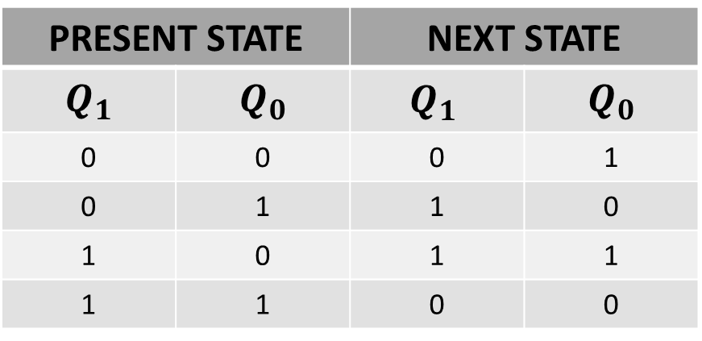
NEXT STATE TABLE
PRESENT STATE |  | NEXT STATE
$$Q_{1}$$ | $$Q_{0}$$ | $${Q_{1}}_{ }$$ | $$Q_{0}$$
0 | 0 | 0 | 1
0 | 1 | 1 | 0
1 | 0 | 1 | 1
1 | 1 | 0 | 0

Slide 6
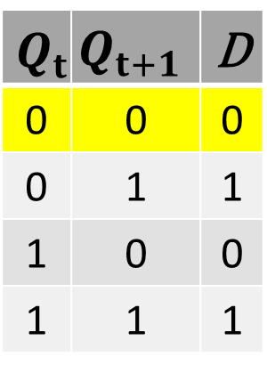
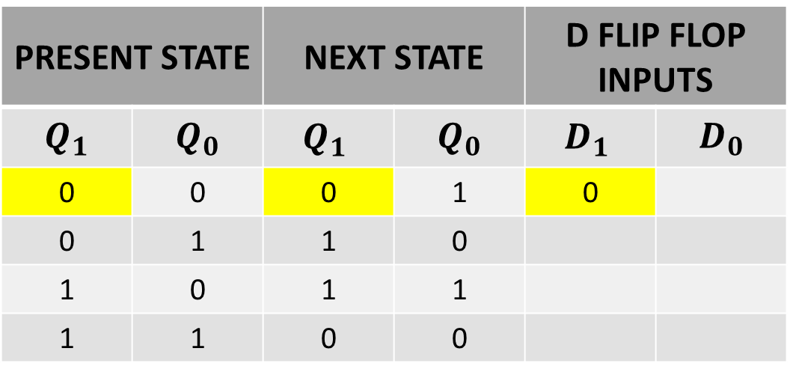
NEXT STATE TABLE USING D FLIP FLOP
$$Q_{t}$$ | $$Q_{t+1}$$ | D
0 | 0 | 0
0 | 1 | 1
1 | 0 | 0
1 | 1 | 1
PRESENT STATE |  | NEXT STATE |  | D FLIP FLOP INPUTS
$$Q_{1}$$ | $$Q_{0}$$ | $${Q_{1}}_{ }$$ | $$Q_{0}$$ | $${D_{1}}_{ }$$ | $$D_{0}$$
0 | 0 | 0 | 1 | 0
0 | 1 | 1 | 0
1 | 0 | 1 | 1
1 | 1 | 0 | 0

Slide 7
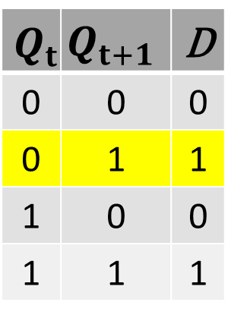
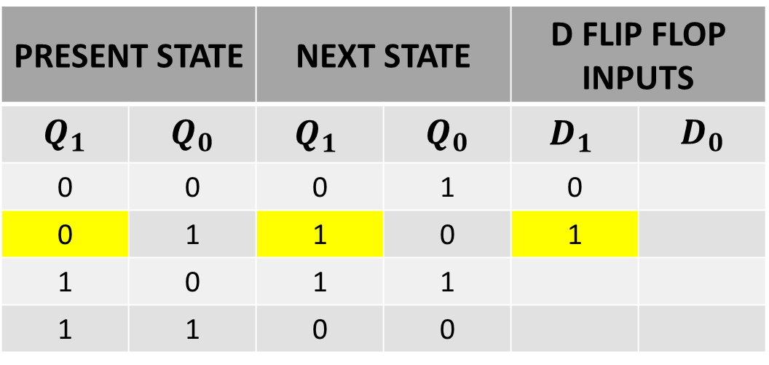
NEXT STATE TABLE USING D FLIP FLOP
$$Q_{t}$$ | $$Q_{t+1}$$ | D
0 | 0 | 0
0 | 1 | 1
1 | 0 | 0
1 | 1 | 1
PRESENT STATE |  | NEXT STATE |  | D FLIP FLOP INPUTS
$$Q_{1}$$ | $$Q_{0}$$ | $${Q_{1}}_{ }$$ | $$Q_{0}$$ | $${D_{1}}_{ }$$ | $$D_{0}$$
0 | 0 | 0 | 1 | 0
0 | 1 | 1 | 0 | 1
1 | 0 | 1 | 1
1 | 1 | 0 | 0

Slide 8
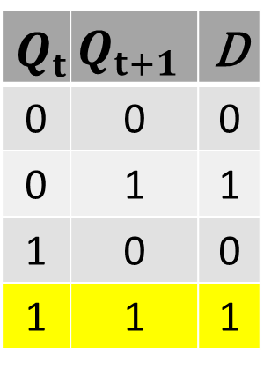
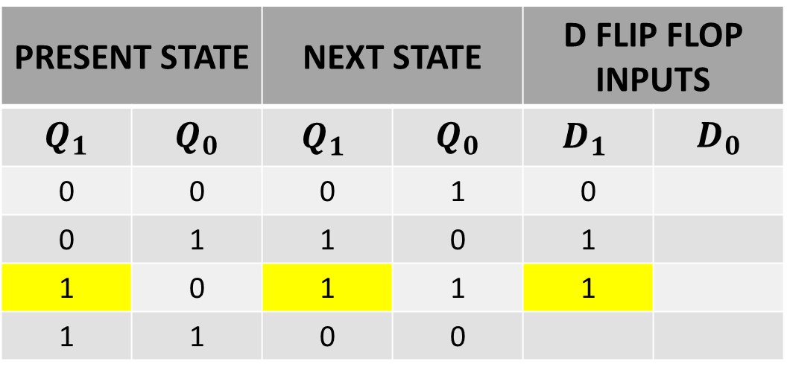
NEXT STATE TABLE USING D FLIP FLOP
$$Q_{t}$$ | $$Q_{t+1}$$ | D
0 | 0 | 0
0 | 1 | 1
1 | 0 | 0
1 | 1 | 1
PRESENT STATE |  | NEXT STATE |  | D FLIP FLOP INPUTS
$$Q_{1}$$ | $$Q_{0}$$ | $${Q_{1}}_{ }$$ | $$Q_{0}$$ | $${D_{1}}_{ }$$ | $$D_{0}$$
0 | 0 | 0 | 1 | 0
0 | 1 | 1 | 0 | 1
1 | 0 | 1 | 1 | 1
1 | 1 | 0 | 0

Slide 9
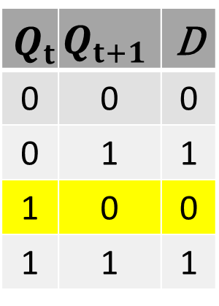
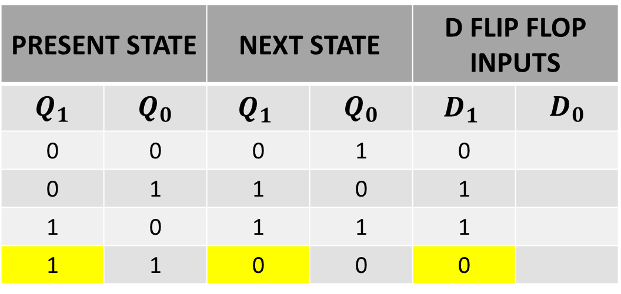
NEXT STATE TABLE USING D FLIP FLOP
$$Q_{t}$$ | $$Q_{t+1}$$ | D
0 | 0 | 0
0 | 1 | 1
1 | 0 | 0
1 | 1 | 1
PRESENT STATE |  | NEXT STATE |  | D FLIP FLOP INPUTS
$$Q_{1}$$ | $$Q_{0}$$ | $${Q_{1}}_{ }$$ | $$Q_{0}$$ | $${D_{1}}_{ }$$ | $$D_{0}$$
0 | 0 | 0 | 1 | 0
0 | 1 | 1 | 0 | 1
1 | 0 | 1 | 1 | 1
1 | 1 | 0 | 0 | 0

Slide 10
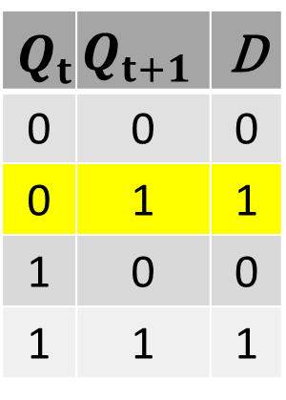
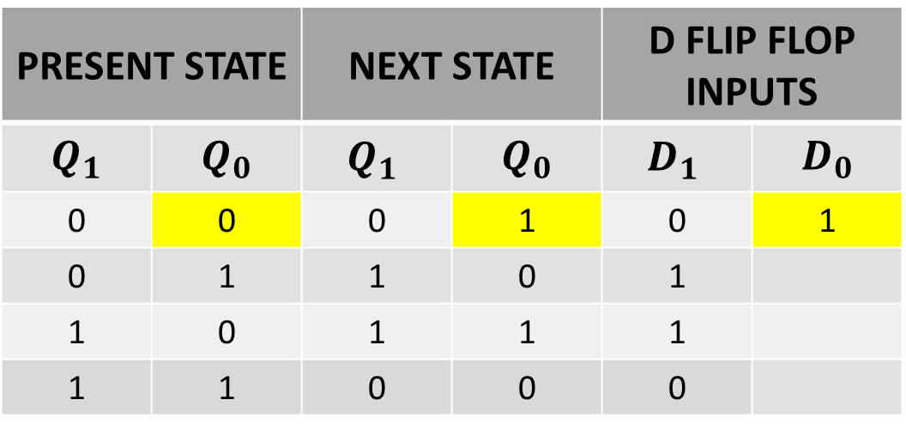
NEXT STATE TABLE USING D FLIP FLOP
$$Q_{t}$$ | $$Q_{t+1}$$ | D
0 | 0 | 0
0 | 1 | 1
1 | 0 | 0
1 | 1 | 1
PRESENT STATE |  | NEXT STATE |  | D FLIP FLOP INPUTS
$$Q_{1}$$ | $$Q_{0}$$ | $${Q_{1}}_{ }$$ | $$Q_{0}$$ | $${D_{1}}_{ }$$ | $$D_{0}$$
0 | 0 | 0 | 1 | 0 | 1
0 | 1 | 1 | 0 | 1
1 | 0 | 1 | 1 | 1
1 | 1 | 0 | 0 | 0

Slide 11
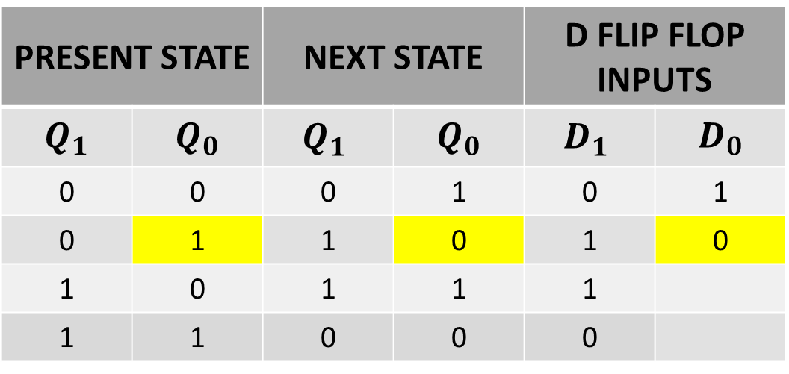
NEXT STATE TABLE USING D FLIP FLOP
$$Q_{t}$$ | $$Q_{t+1}$$ | D
0 | 0 | 0
0 | 1 | 1
1 | 0 | 0
1 | 1 | 1
PRESENT STATE |  | NEXT STATE |  | D FLIP FLOP INPUTS
$$Q_{1}$$ | $$Q_{0}$$ | $${Q_{1}}_{ }$$ | $$Q_{0}$$ | $${D_{1}}_{ }$$ | $$D_{0}$$
0 | 0 | 0 | 1 | 0 | 1
0 | 1 | 1 | 0 | 1 | 0
1 | 0 | 1 | 1 | 1
1 | 1 | 0 | 0 | 0

Slide 12
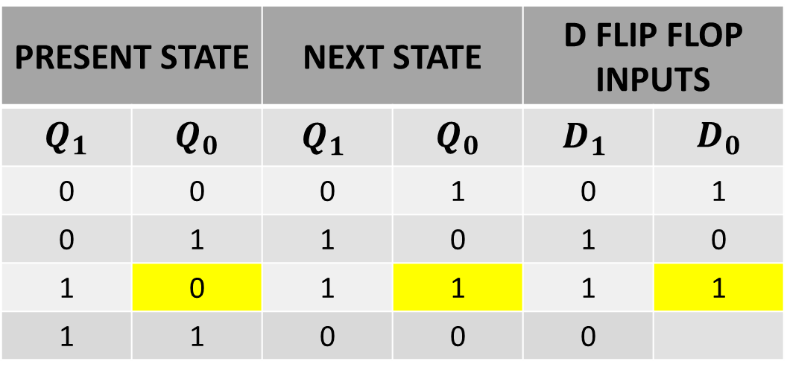
NEXT STATE TABLE USING D FLIP FLOP
$$Q_{t}$$ | $$Q_{t+1}$$ | D
0 | 0 | 0
0 | 1 | 1
1 | 0 | 0
1 | 1 | 1
PRESENT STATE |  | NEXT STATE |  | D FLIP FLOP INPUTS
$$Q_{1}$$ | $$Q_{0}$$ | $${Q_{1}}_{ }$$ | $$Q_{0}$$ | $${D_{1}}_{ }$$ | $$D_{0}$$
0 | 0 | 0 | 1 | 0 | 1
0 | 1 | 1 | 0 | 1 | 0
1 | 0 | 1 | 1 | 1 | 1
1 | 1 | 0 | 0 | 0

Slide 13
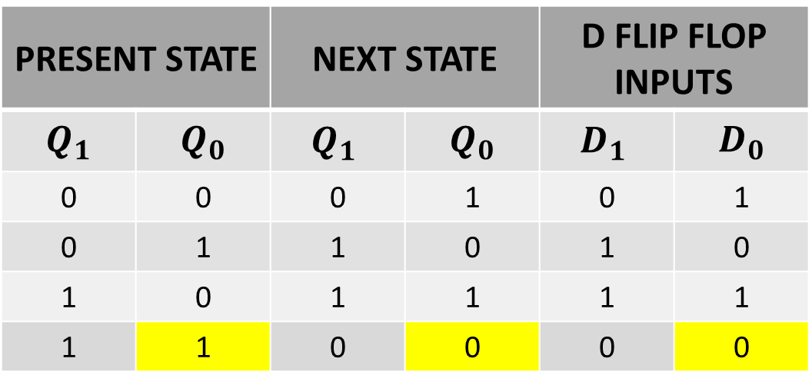
NEXT STATE TABLE USING D FLIP FLOP
$$Q_{t}$$ | $$Q_{t+1}$$ | D
0 | 0 | 0
0 | 1 | 1
1 | 0 | 0
1 | 1 | 1
PRESENT STATE |  | NEXT STATE |  | D FLIP FLOP INPUTS
$$Q_{1}$$ | $$Q_{0}$$ | $${Q_{1}}_{ }$$ | $$Q_{0}$$ | $${D_{1}}_{ }$$ | $$D_{0}$$
0 | 0 | 0 | 1 | 0 | 1
0 | 1 | 1 | 0 | 1 | 0
1 | 0 | 1 | 1 | 1 | 1
1 | 1 | 0 | 0 | 0 | 0

Slide 14
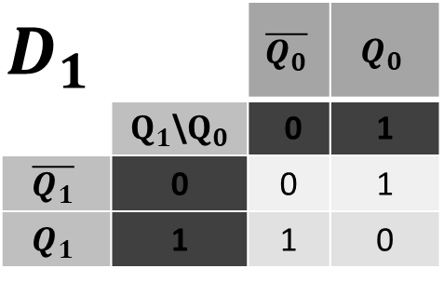
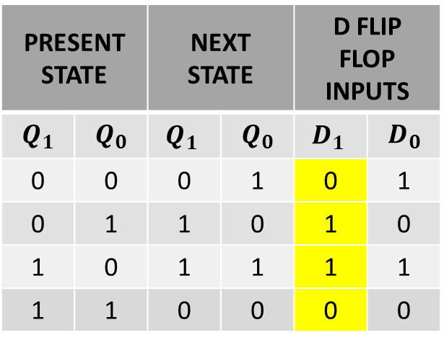
SIMPLIFICATION(K-MAP)
PRESENT STATE |  | NEXT STATE |  | D FLIP FLOP INPUTS
$$Q_{1}$$ | $$Q_{0}$$ | $${Q_{1}}_{ }$$ | $$Q_{0}$$ | $${D_{1}}_{ }$$ | $$D_{0}$$
0 | 0 | 0 | 1 | 0 | 1
0 | 1 | 1 | 0 | 1 | 0
1 | 0 | 1 | 1 | 1 | 1
1 | 1 | 0 | 0 | 0 | 0
$$D_{1}$$ |  | $$\overline{Q_{0}}$$ | $$Q_{0}$$
 | $Q_{1}$\$Q_{0}$ | 0 | 1
$$\overline{Q_{1}}$$ | 0 | 0 | 1
$$Q_{1}$$ | 1 | 1 | 0

Slide 15
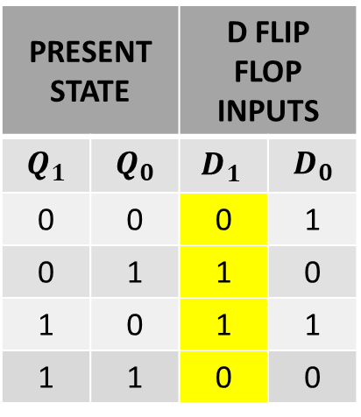
SIMPLIFICATION(K-MAP)
PRESENT STATE |  | D FLIP FLOP INPUTS
$$Q_{1}$$ | $$Q_{0}$$ | $${D_{1}}_{ }$$ | $$D_{0}$$
0 | 0 | 0 | 1
0 | 1 | 1 | 0
1 | 0 | 1 | 1
1 | 1 | 0 | 0
$$D_{1}$$ |  | $$\overline{Q_{0}}$$ | $$Q_{0}$$
 | $Q_{1}$\$Q_{0}$ | 0 | 1
$$\overline{Q_{1}}$$ | 0 | 0 | 1
$$Q_{1}$$ | 1 | 1 | 0

Slide 16
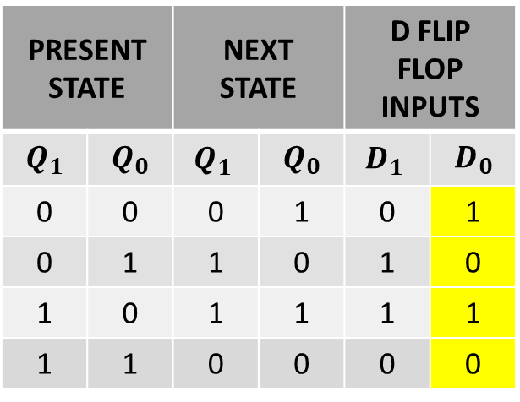
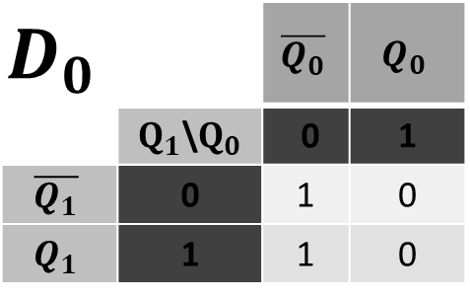
SIMPLIFICATION(K-MAP)
PRESENT STATE |  | NEXT STATE |  | D FLIP FLOP INPUTS
$$Q_{1}$$ | $$Q_{0}$$ | $${Q_{1}}_{ }$$ | $$Q_{0}$$ | $${D_{1}}_{ }$$ | $$D_{0}$$
0 | 0 | 0 | 1 | 0 | 1
0 | 1 | 1 | 0 | 1 | 0
1 | 0 | 1 | 1 | 1 | 1
1 | 1 | 0 | 0 | 0 | 0
$$D_{1}$$ |  | $$\overline{Q_{0}}$$ | $$Q_{0}$$
 | $Q_{1}$\$Q_{0}$ | 0 | 1
$$\overline{Q_{1}}$$ | 0 | 0 | 1
$$Q_{1}$$ | 1 | 1 | 0
$$D_{0}$$ |  | $$\overline{Q_{0}}$$ | $$Q_{0}$$
 | $Q_{1}$\$Q_{0}$ | 0 | 1
$$\overline{Q_{1}}$$ | 0 | 1 | 0
$$Q_{1}$$ | 1 | 1 | 0

Slide 17
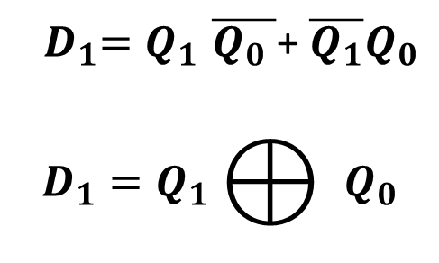

INPUT EQUATIONS
$$D_{1}$$ |  | $$\overline{Q_{0}}$$ | $$Q_{0}$$
 | $Q_{1}$\$Q_{0}$ | 0 | 1
$$\overline{Q_{1}}$$ | 0 | 0 | 1
$$Q_{1}$$ | 1 | 1 | 0
${ D}_{1}{=Q}_{1}\overline{Q_{0} }$+ $\overline{Q_{1}}Q_{0}$
$$D_{1}{=Q}_{1}⨁{ }Q_{0}$$
$$D_{0}$$ |  | $$\overline{Q_{0}}$$ | $$Q_{0}$$
 | $Q_{1}$\$Q_{0}$ | 0 | 1
$$\overline{Q_{1}}$$ | 0 | 1 | 0
$$Q_{1}$$ | 1 | 1 | 0
$${ D}_{0}{= }_{ }\overline{Q_{0} }$$

Slide 18
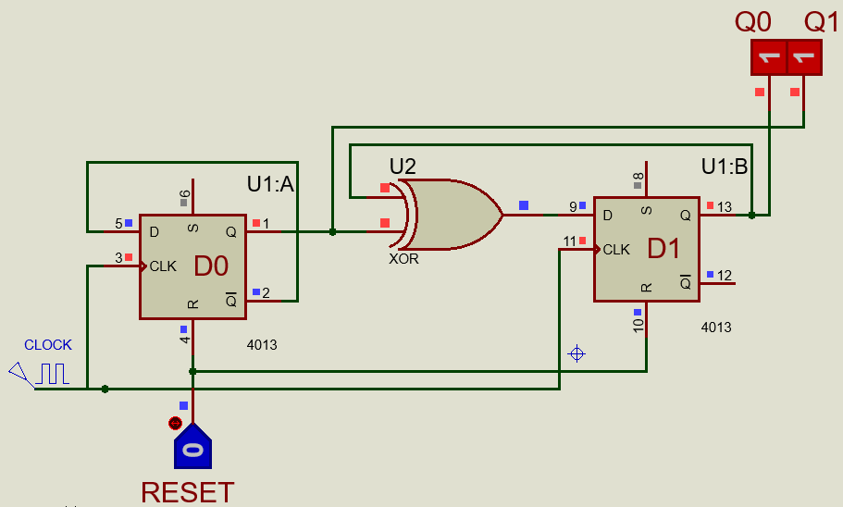
IMPLEMENTATIONS OF EQUATION

Slide 19
SEQUENTIAL CIRCUIT DESIGN
EXAMPLE 1 using T Flip Flop
LECTURE 8

Slide 20
STEPS FOR SEQUENTIAL CIRCUIT DESIGN
State Diagram
Next State Table
State Reduction And Assignment
Flip Flop Transition Table (FLIP FLOP Selection)
Simplification
Input/output Equations
Implementations of Equation(Logic Diagram)

Slide 21
STATE DIAGRAM
00
11
01
10

Slide 22
STATE DIAGRAM
$${Q_{1}Q}_{0}$$
0 0
$${Q_{1}Q}_{0}$$
1 1
$${Q_{1}Q}_{0}$$
0 1
$${Q_{1}Q}_{0}$$
1 0

Slide 23
NEXT STATE TABLE
PRESENT STATE |  | NEXT STATE
$$Q_{1}$$ | $$Q_{0}$$ | $${Q_{1}}_{ }$$ | $$Q_{0}$$
0 | 0 | 0 | 1
0 | 1 | 1 | 0
1 | 0 | 1 | 1
1 | 1 | 0 | 0

Slide 24
NEXT STATE TABLE USING T FLIP FLOP
$$Q_{t}$$ | $$Q_{t+1}$$ | T
0 | 0 | 0
0 | 1 | 1
1 | 0 | 1
1 | 1 | 0
PRESENT STATE |  | NEXT STATE |  | T FLIP FLOP INPUTS
$$Q_{1}$$ | $$Q_{0}$$ | $${Q_{1}}_{ }$$ | $$Q_{0}$$ | $${T_{1}}_{ }$$ | $$T_{0}$$
0 | 0 | 0 | 1 | 0
0 | 1 | 1 | 0
1 | 0 | 1 | 1
1 | 1 | 0 | 0

Slide 25
NEXT STATE TABLE USING T FLIP FLOP
$$Q_{t}$$ | $$Q_{t+1}$$ | T
0 | 0 | 0
0 | 1 | 1
1 | 0 | 1
1 | 1 | 0
PRESENT STATE |  | NEXT STATE |  | T FLIP FLOP INPUTS
$$Q_{1}$$ | $$Q_{0}$$ | $${Q_{1}}_{ }$$ | $$Q_{0}$$ | $${T_{1}}_{ }$$ | $$T_{0}$$
0 | 0 | 0 | 1 | 0
0 | 1 | 1 | 0 | 1
1 | 0 | 1 | 1
1 | 1 | 0 | 0

Slide 26
NEXT STATE TABLE USING T FLIP FLOP
$$Q_{t}$$ | $$Q_{t+1}$$ | T
0 | 0 | 0
0 | 1 | 1
1 | 0 | 1
1 | 1 | 0
PRESENT STATE |  | NEXT STATE |  | T FLIP FLOP INPUTS
$$Q_{1}$$ | $$Q_{0}$$ | $${Q_{1}}_{ }$$ | $$Q_{0}$$ | $${T_{1}}_{ }$$ | $$T_{0}$$
0 | 0 | 0 | 1 | 0
0 | 1 | 1 | 0 | 1
1 | 0 | 1 | 1 | 0
1 | 1 | 0 | 0

Slide 27
NEXT STATE TABLE USING T FLIP FLOP
$$Q_{t}$$ | $$Q_{t+1}$$ | T
0 | 0 | 0
0 | 1 | 1
1 | 0 | 1
1 | 1 | 0
PRESENT STATE |  | NEXT STATE |  | T FLIP FLOP INPUTS
$$Q_{1}$$ | $$Q_{0}$$ | $${Q_{1}}_{ }$$ | $$Q_{0}$$ | $${T_{1}}_{ }$$ | $$T_{0}$$
0 | 0 | 0 | 1 | 0
0 | 1 | 1 | 0 | 1
1 | 0 | 1 | 1 | 0
1 | 1 | 0 | 0 | 1

Slide 28
NEXT STATE TABLE USING T FLIP FLOP
$$Q_{t}$$ | $$Q_{t+1}$$ | T
0 | 0 | 0
0 | 1 | 1
1 | 0 | 1
1 | 1 | 0
PRESENT STATE |  | NEXT STATE |  | T FLIP FLOP INPUTS
$$Q_{1}$$ | $$Q_{0}$$ | $${Q_{1}}_{ }$$ | $$Q_{0}$$ | $${T_{1}}_{ }$$ | $$T_{0}$$
0 | 0 | 0 | 1 | 0 | 1
0 | 1 | 1 | 0 | 1
1 | 0 | 1 | 1 | 0
1 | 1 | 0 | 0 | 1

Slide 29
NEXT STATE TABLE USING T FLIP FLOP
$$Q_{t}$$ | $$Q_{t+1}$$ | T
0 | 0 | 0
0 | 1 | 1
1 | 0 | 1
1 | 1 | 0
PRESENT STATE |  | NEXT STATE |  | T FLIP FLOP INPUTS
$$Q_{1}$$ | $$Q_{0}$$ | $${Q_{1}}_{ }$$ | $$Q_{0}$$ | $${T_{1}}_{ }$$ | $$T_{0}$$
0 | 0 | 0 | 1 | 0 | 1
0 | 1 | 1 | 0 | 1 | 1
1 | 0 | 1 | 1 | 0
1 | 1 | 0 | 0 | 1

Slide 30
NEXT STATE TABLE USING T FLIP FLOP
$$Q_{t}$$ | $$Q_{t+1}$$ | T
0 | 0 | 0
0 | 1 | 1
1 | 0 | 1
1 | 1 | 0
PRESENT STATE |  | NEXT STATE |  | T FLIP FLOP INPUTS
$$Q_{1}$$ | $$Q_{0}$$ | $${Q_{1}}_{ }$$ | $$Q_{0}$$ | $${T_{1}}_{ }$$ | $$T_{0}$$
0 | 0 | 0 | 1 | 0 | 1
0 | 1 | 1 | 0 | 1 | 1
1 | 0 | 1 | 1 | 0 | 1
1 | 1 | 0 | 0 | 1

Slide 31
NEXT STATE TABLE USING T FLIP FLOP
$$Q_{t}$$ | $$Q_{t+1}$$ | T
0 | 0 | 0
0 | 1 | 1
1 | 0 | 1
1 | 1 | 0
PRESENT STATE |  | NEXT STATE |  | T FLIP FLOP INPUTS
$$Q_{1}$$ | $$Q_{0}$$ | $${Q_{1}}_{ }$$ | $$Q_{0}$$ | $${T_{1}}_{ }$$ | $$T_{0}$$
0 | 0 | 0 | 1 | 0 | 1
0 | 1 | 1 | 0 | 1 | 1
1 | 0 | 1 | 1 | 0 | 1
1 | 1 | 0 | 0 | 1 | 1

Slide 32
NEXT STATE TABLE USING T FLIP FLOP
PRESENT STATE |  | NEXT STATE |  | T FLIP FLOP INPUTS
$$Q_{1}$$ | $$Q_{0}$$ | $${Q_{1}}_{ }$$ | $$Q_{0}$$ | $${T_{1}}_{ }$$ | $$T_{0}$$
0 | 0 | 0 | 1 | 0 | 1
0 | 1 | 1 | 0 | 1 | 1
1 | 0 | 1 | 1 | 0 | 1
1 | 1 | 0 | 0 | 1 | 1

Slide 33
SIMPLIFICATION(K-MAP)
PRESENT STATE |  | NEXT STATE |  | T FLIP FLOP INPUTS
$$Q_{1}$$ | $$Q_{0}$$ | $${Q_{1}}_{ }$$ | $$Q_{0}$$ | $${T_{1}}_{ }$$ | $$T_{0}$$
0 | 0 | 0 | 1 | 0 | 1
0 | 1 | 1 | 0 | 1 | 1
1 | 0 | 1 | 1 | 0 | 1
1 | 1 | 0 | 0 | 1 | 1
$$T_{1}$$ |  | $$\overline{Q_{0}}$$ | $$Q_{0}$$
 | $Q_{1}$\$Q_{0}$ | 0 | 1
$$\overline{Q_{1}}$$ | 0 | 0 | 1
$$Q_{1}$$ | 1 | 0 | 1
$$T_{0}$$ |  | $$\overline{Q_{0}}$$ | $$Q_{0}$$
 | $Q_{1}$\$Q_{0}$ | 0 | 1
$$\overline{Q_{1}}$$ | 0 | 1 | 1
$$Q_{1}$$ | 1 | 1 | 1

Slide 34
INPUT EQUATIONS
PRESENT STATE |  | NEXT STATE |  | T FLIP FLOP INPUTS
$$Q_{1}$$ | $$Q_{0}$$ | $${Q_{1}}_{ }$$ | $$Q_{0}$$ | $${T_{1}}_{ }$$ | $$T_{0}$$
0 | 0 | 0 | 1 | 0 | 1
0 | 1 | 1 | 0 | 1 | 1
1 | 0 | 1 | 1 | 0 | 1
1 | 1 | 0 | 0 | 1 | 1
$$T_{1}$$ |  | $$\overline{Q_{0}}$$ | $$Q_{0}$$
 | $Q_{1}$\$Q_{0}$ | 0 | 1
$$\overline{Q_{1}}$$ | 0 | 0 | 1
$$Q_{1}$$ | 1 | 0 | 1
$${ T}_{1}{= }_{ }{ Q}_{0}$$
$$T_{0}$$ |  | $$\overline{Q_{0}}$$ | $$Q_{0}$$
 | $Q_{1}$\$Q_{0}$ | 0 | 1
$$\overline{Q_{1}}$$ | 0 | 1 | 1
$$Q_{1}$$ | 1 | 1 | 1
$${ T}_{0}{= }_{ }1$$

Slide 35
IMPLEMENTATIONS OF EQUATION

Slide 36
SEQUENTIAL CIRCUIT DESIGN
EXAMPLE 1 (2 BIT SYNCHRONOUS COUNTER) using JK Flip Flop
LECTURE 8

Slide 37
STEPS FOR SEQUENTIAL CIRCUIT DESIGN
State Diagram
Next State Table
State Reduction And Assignment
Flip Flop Transition Table (FLIP FLOP Selection)
Simplification
Input/output Equations
Implementations of Equation(Logic Diagram)

Slide 38
STATE DIAGRAM
00
11
01
10

Slide 39
STATE DIAGRAM
$${Q_{1}Q}_{0}$$
0 0
$${Q_{1}Q}_{0}$$
1 1
$${Q_{1}Q}_{0}$$
0 1
$${Q_{1}Q}_{0}$$
1 0

Slide 40
NEXT STATE TABLE
PRESENT STATE |  | NEXT STATE
$$Q_{1}$$ | $$Q_{0}$$ | $${Q_{1}}_{ }$$ | $$Q_{0}$$
0 | 0 | 0 | 1
0 | 1 | 1 | 0
1 | 0 | 1 | 1
1 | 1 | 0 | 0

Slide 41
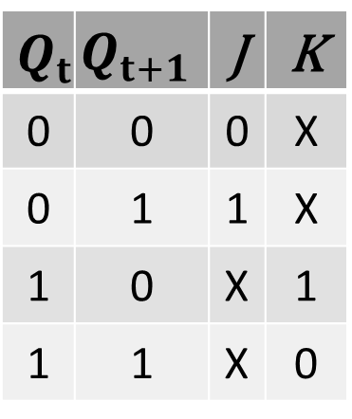
NEXT STATE TABLE USING JK FLIP FLOP
$$Q_{t}$$ | $$Q_{t+1}$$ | J | K
0 | 0 | 0 | X
0 | 1 | 1 | X
1 | 0 | X | 1
1 | 1 | X | 0

Slide 42
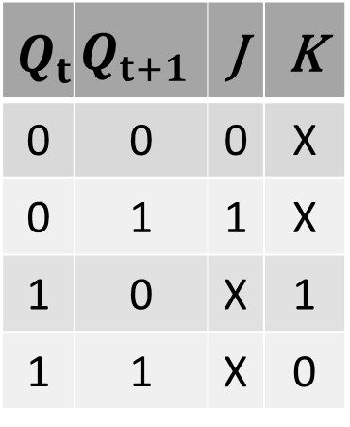
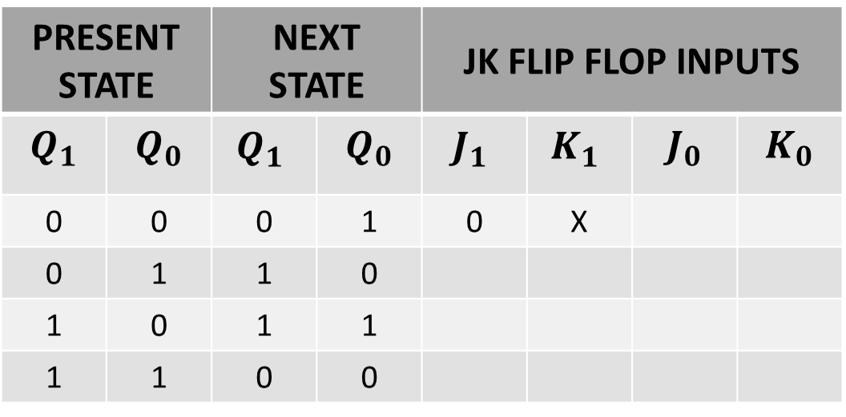
NEXT STATE TABLE USING JK FLIP FLOP
$$Q_{t}$$ | $$Q_{t+1}$$ | J | K
0 | 0 | 0 | X
0 | 1 | 1 | X
1 | 0 | X | 1
1 | 1 | X | 0
PRESENT STATE |  | NEXT STATE |  | JK FLIP FLOP INPUTS
$$Q_{1}$$ | $$Q_{0}$$ | $${Q_{1}}_{ }$$ | $$Q_{0}$$ | $${J_{1}}_{ }$$ | $${K_{1}}_{ }$$ | $$J_{0}$$ | $$K_{0}$$
0 | 0 | 0 | 1 | 0 | X
0 | 1 | 1 | 0
1 | 0 | 1 | 1
1 | 1 | 0 | 0

Slide 43
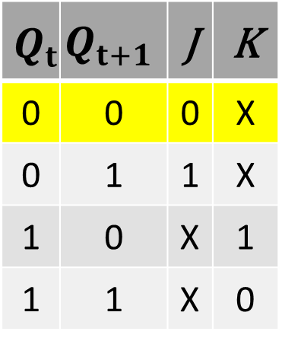
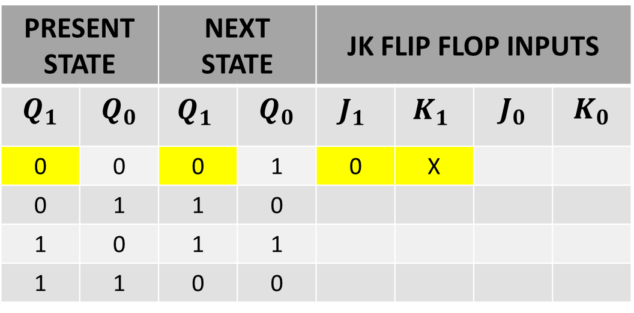
NEXT STATE TABLE USING JK FLIP FLOP
$$Q_{t}$$ | $$Q_{t+1}$$ | J | K
0 | 0 | 0 | X
0 | 1 | 1 | X
1 | 0 | X | 1
1 | 1 | X | 0
PRESENT STATE |  | NEXT STATE |  | JK FLIP FLOP INPUTS
$$Q_{1}$$ | $$Q_{0}$$ | $${Q_{1}}_{ }$$ | $$Q_{0}$$ | $${J_{1}}_{ }$$ | $${K_{1}}_{ }$$ | $$J_{0}$$ | $$K_{0}$$
0 | 0 | 0 | 1 | 0 | X
0 | 1 | 1 | 0
1 | 0 | 1 | 1
1 | 1 | 0 | 0

Slide 44
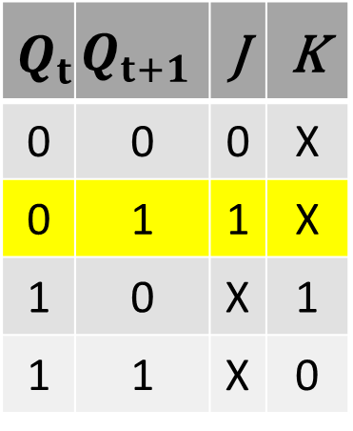
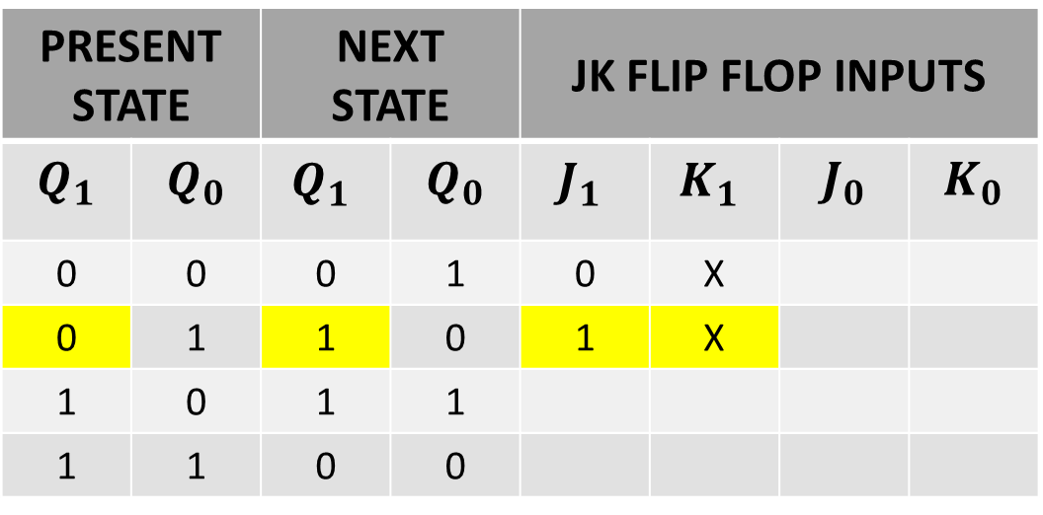
NEXT STATE TABLE USING JK FLIP FLOP
$$Q_{t}$$ | $$Q_{t+1}$$ | J | K
0 | 0 | 0 | X
0 | 1 | 1 | X
1 | 0 | X | 1
1 | 1 | X | 0
PRESENT STATE |  | NEXT STATE |  | JK FLIP FLOP INPUTS
$$Q_{1}$$ | $$Q_{0}$$ | $${Q_{1}}_{ }$$ | $$Q_{0}$$ | $${J_{1}}_{ }$$ | $${K_{1}}_{ }$$ | $$J_{0}$$ | $$K_{0}$$
0 | 0 | 0 | 1 | 0 | X
0 | 1 | 1 | 0 | 1 | X
1 | 0 | 1 | 1
1 | 1 | 0 | 0

Slide 45
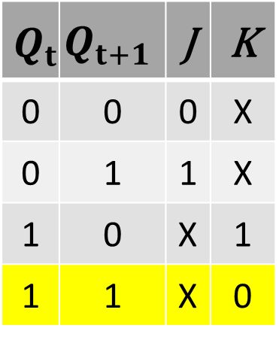
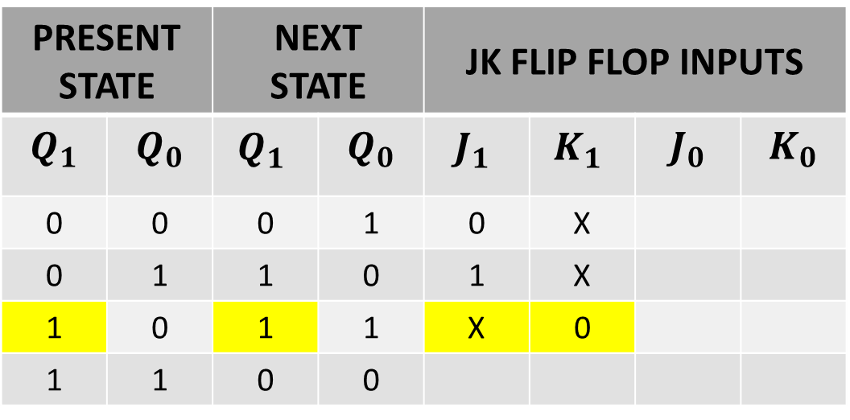
NEXT STATE TABLE USING JK FLIP FLOP
$$Q_{t}$$ | $$Q_{t+1}$$ | J | K
0 | 0 | 0 | X
0 | 1 | 1 | X
1 | 0 | X | 1
1 | 1 | X | 0
PRESENT STATE |  | NEXT STATE |  | JK FLIP FLOP INPUTS
$$Q_{1}$$ | $$Q_{0}$$ | $${Q_{1}}_{ }$$ | $$Q_{0}$$ | $${J_{1}}_{ }$$ | $${K_{1}}_{ }$$ | $$J_{0}$$ | $$K_{0}$$
0 | 0 | 0 | 1 | 0 | X
0 | 1 | 1 | 0 | 1 | X
1 | 0 | 1 | 1 | X | 0
1 | 1 | 0 | 0

Slide 46
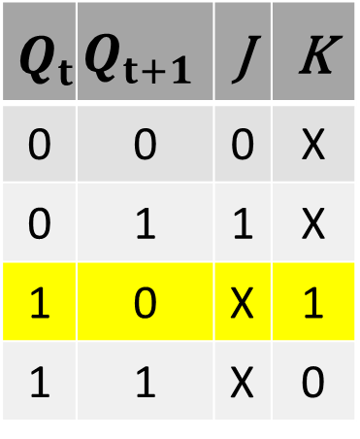
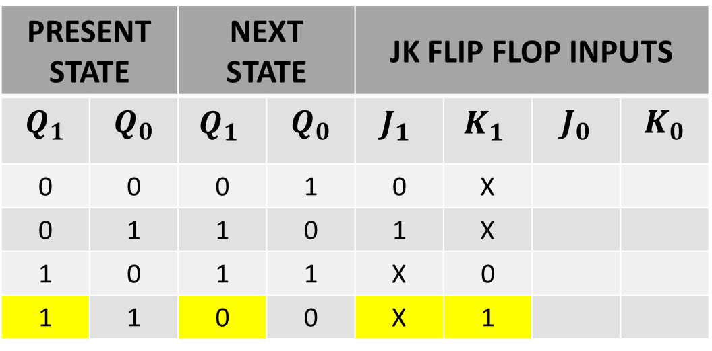
NEXT STATE TABLE USING JK FLIP FLOP
$$Q_{t}$$ | $$Q_{t+1}$$ | J | K
0 | 0 | 0 | X
0 | 1 | 1 | X
1 | 0 | X | 1
1 | 1 | X | 0
PRESENT STATE |  | NEXT STATE |  | JK FLIP FLOP INPUTS
$$Q_{1}$$ | $$Q_{0}$$ | $${Q_{1}}_{ }$$ | $$Q_{0}$$ | $${J_{1}}_{ }$$ | $${K_{1}}_{ }$$ | $$J_{0}$$ | $$K_{0}$$
0 | 0 | 0 | 1 | 0 | X
0 | 1 | 1 | 0 | 1 | X
1 | 0 | 1 | 1 | X | 0
1 | 1 | 0 | 0 | X | 1

Slide 47
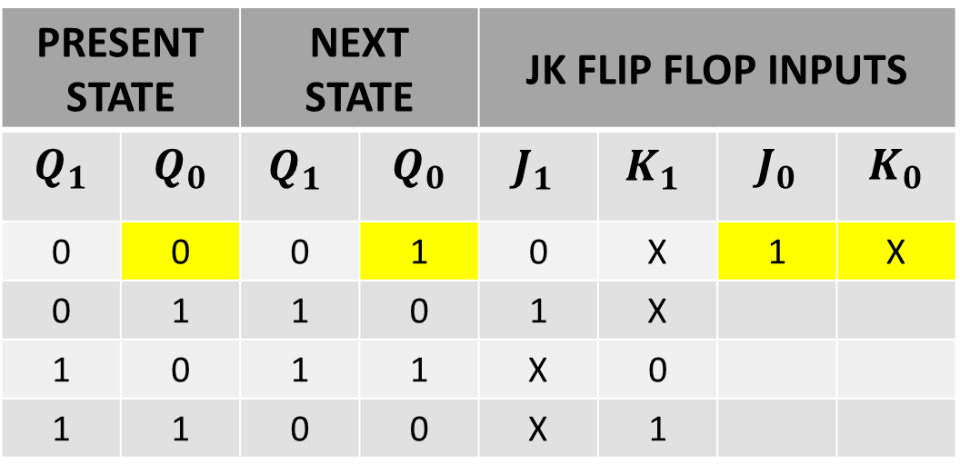
NEXT STATE TABLE USING JK FLIP FLOP
$$Q_{t}$$ | $$Q_{t+1}$$ | J | K
0 | 0 | 0 | X
0 | 1 | 1 | X
1 | 0 | X | 1
1 | 1 | X | 0
PRESENT STATE |  | NEXT STATE |  | JK FLIP FLOP INPUTS
$$Q_{1}$$ | $$Q_{0}$$ | $${Q_{1}}_{ }$$ | $$Q_{0}$$ | $${J_{1}}_{ }$$ | $${K_{1}}_{ }$$ | $$J_{0}$$ | $$K_{0}$$
0 | 0 | 0 | 1 | 0 | X | 1 | X
0 | 1 | 1 | 0 | 1 | X
1 | 0 | 1 | 1 | X | 0
1 | 1 | 0 | 0 | X | 1

Slide 48
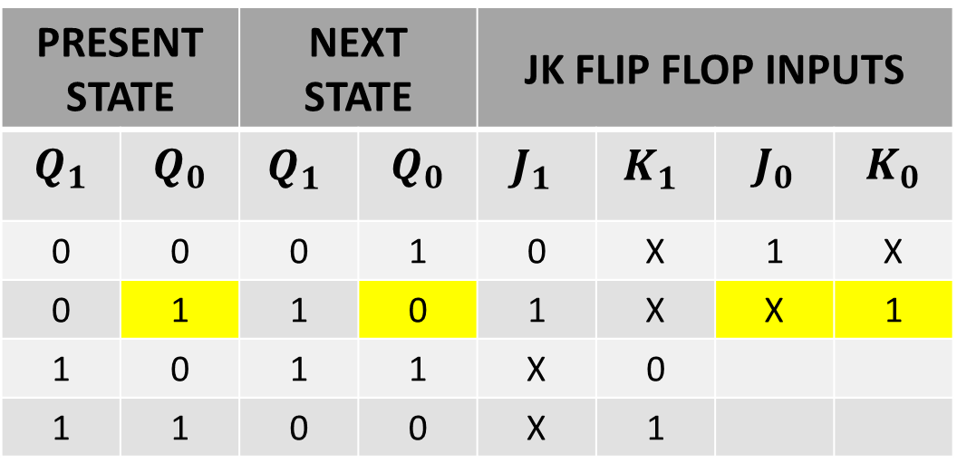
NEXT STATE TABLE USING JK FLIP FLOP
$$Q_{t}$$ | $$Q_{t+1}$$ | J | K
0 | 0 | 0 | X
0 | 1 | 1 | X
1 | 0 | X | 1
1 | 1 | X | 0
PRESENT STATE |  | NEXT STATE |  | JK FLIP FLOP INPUTS
$$Q_{1}$$ | $$Q_{0}$$ | $${Q_{1}}_{ }$$ | $$Q_{0}$$ | $${J_{1}}_{ }$$ | $${K_{1}}_{ }$$ | $$J_{0}$$ | $$K_{0}$$
0 | 0 | 0 | 1 | 0 | X | 1 | X
0 | 1 | 1 | 0 | 1 | X | X | 1
1 | 0 | 1 | 1 | X | 0
1 | 1 | 0 | 0 | X | 1

Slide 49
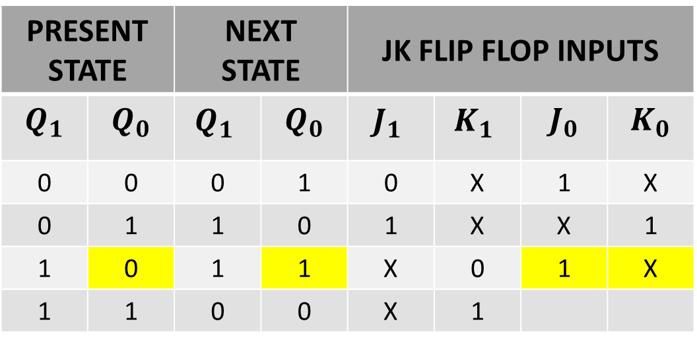
NEXT STATE TABLE USING JK FLIP FLOP
$$Q_{t}$$ | $$Q_{t+1}$$ | J | K
0 | 0 | 0 | X
0 | 1 | 1 | X
1 | 0 | X | 1
1 | 1 | X | 0
PRESENT STATE |  | NEXT STATE |  | JK FLIP FLOP INPUTS
$$Q_{1}$$ | $$Q_{0}$$ | $${Q_{1}}_{ }$$ | $$Q_{0}$$ | $${J_{1}}_{ }$$ | $${K_{1}}_{ }$$ | $$J_{0}$$ | $$K_{0}$$
0 | 0 | 0 | 1 | 0 | X | 1 | X
0 | 1 | 1 | 0 | 1 | X | X | 1
1 | 0 | 1 | 1 | X | 0 | 1 | X
1 | 1 | 0 | 0 | X | 1

Slide 50
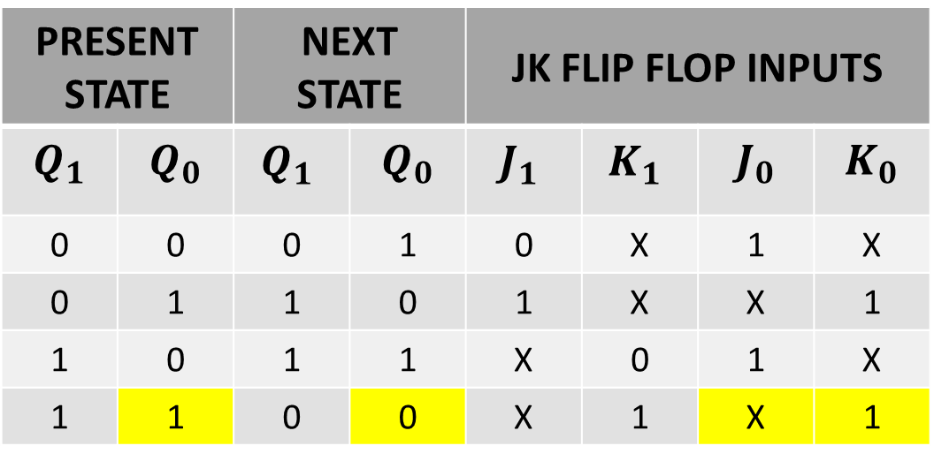
NEXT STATE TABLE USING JK FLIP FLOP
$$Q_{t}$$ | $$Q_{t+1}$$ | J | K
0 | 0 | 0 | X
0 | 1 | 1 | X
1 | 0 | X | 1
1 | 1 | X | 0
PRESENT STATE |  | NEXT STATE |  | JK FLIP FLOP INPUTS
$$Q_{1}$$ | $$Q_{0}$$ | $${Q_{1}}_{ }$$ | $$Q_{0}$$ | $${J_{1}}_{ }$$ | $${K_{1}}_{ }$$ | $$J_{0}$$ | $$K_{0}$$
0 | 0 | 0 | 1 | 0 | X | 1 | X
0 | 1 | 1 | 0 | 1 | X | X | 1
1 | 0 | 1 | 1 | X | 0 | 1 | X
1 | 1 | 0 | 0 | X | 1 | X | 1

Slide 51
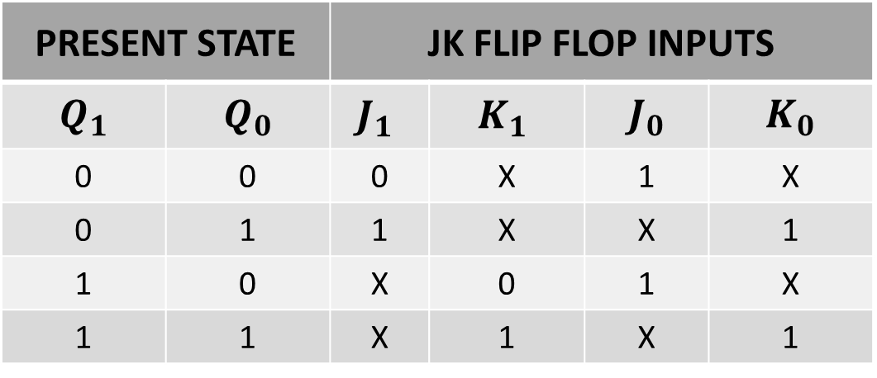
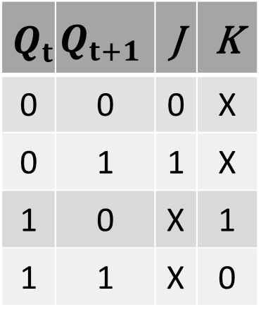
NEXT STATE TABLE USING JK FLIP FLOP
$$Q_{t}$$ | $$Q_{t+1}$$ | J | K
0 | 0 | 0 | X
0 | 1 | 1 | X
1 | 0 | X | 1
1 | 1 | X | 0
PRESENT STATE |  | JK FLIP FLOP INPUTS
$$Q_{1}$$ | $$Q_{0}$$ | $${J_{1}}_{ }$$ | $${K_{1}}_{ }$$ | $$J_{0}$$ | $$K_{0}$$
0 | 0 | 0 | X | 1 | X
0 | 1 | 1 | X | X | 1
1 | 0 | X | 0 | 1 | X
1 | 1 | X | 1 | X | 1

Slide 52
NEXT STATE TABLE USING JK FLIP FLOP
PRESENT STATE |  | JK FLIP FLOP INPUTS
$$Q_{1}$$ | $$Q_{0}$$ | $${J_{1}}_{ }$$ | $${K_{1}}_{ }$$ | $$J_{0}$$ | $$K_{0}$$
0 | 0 | 0 | X | 1 | X
0 | 1 | 1 | X | X | 1
1 | 0 | X | 0 | 1 | X
1 | 1 | X | 1 | X | 1

Slide 53
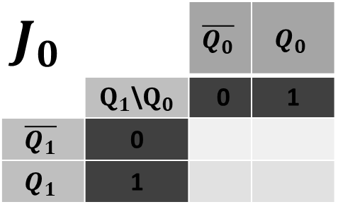
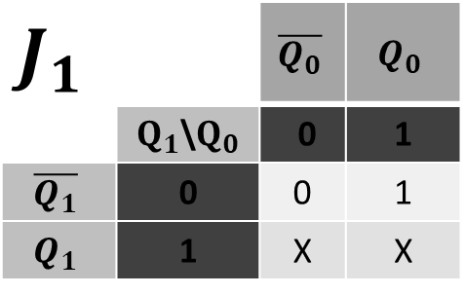
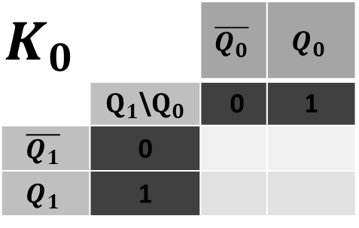
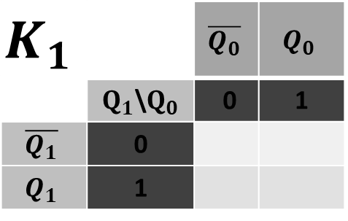
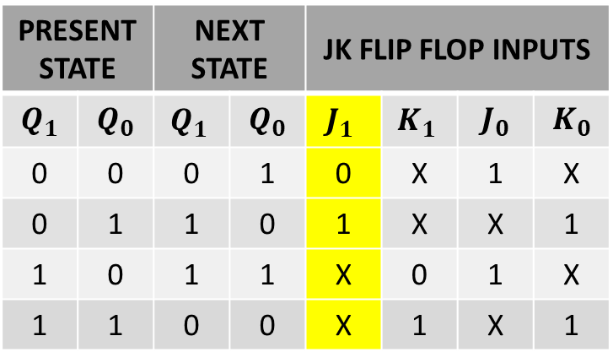
SIMPLIFICATION(K-MAP)
PRESENT STATE |  | NEXT STATE |  | JK FLIP FLOP INPUTS
$$Q_{1}$$ | $$Q_{0}$$ | $${Q_{1}}_{ }$$ | $$Q_{0}$$ | $${J_{1}}_{ }$$ | $${K_{1}}_{ }$$ | $$J_{0}$$ | $$K_{0}$$
0 | 0 | 0 | 1 | 0 | X | 1 | X
0 | 1 | 1 | 0 | 1 | X | X | 1
1 | 0 | 1 | 1 | X | 0 | 1 | X
1 | 1 | 0 | 0 | X | 1 | X | 1
$$J_{1}$$ |  | $$\overline{Q_{0}}$$ | $$Q_{0}$$
 | $Q_{1}$\$Q_{0}$ | 0 | 1
$$\overline{Q_{1}}$$ | 0 | 0 | 1
$$Q_{1}$$ | 1 | X | X
$$J_{0}$$ |  | $$\overline{Q_{0}}$$ | $$Q_{0}$$
 | $Q_{1}$\$Q_{0}$ | 0 | 1
$$\overline{Q_{1}}$$ | 0
$$Q_{1}$$ | 1
$$K_{1}$$ |  | $$\overline{Q_{0}}$$ | $$Q_{0}$$
 | $Q_{1}$\$Q_{0}$ | 0 | 1
$$\overline{Q_{1}}$$ | 0
$$Q_{1}$$ | 1
$$K_{0}$$ |  | $$\overline{Q_{0}}$$ | $$Q_{0}$$
 | $Q_{1}$\$Q_{0}$ | 0 | 1
$$\overline{Q_{1}}$$ | 0
$$Q_{1}$$ | 1

Slide 54
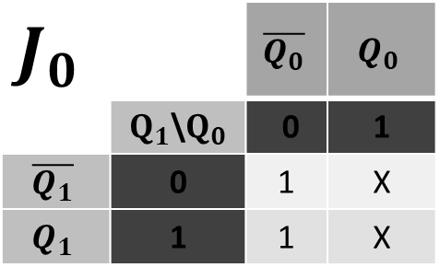
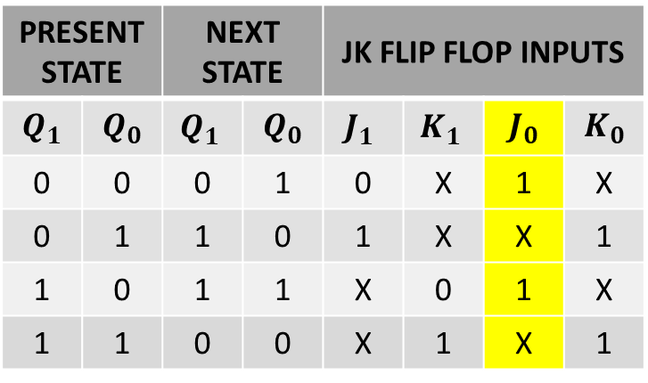
SIMPLIFICATION(K-MAP)
PRESENT STATE |  | NEXT STATE |  | JK FLIP FLOP INPUTS
$$Q_{1}$$ | $$Q_{0}$$ | $${Q_{1}}_{ }$$ | $$Q_{0}$$ | $${J_{1}}_{ }$$ | $${K_{1}}_{ }$$ | $$J_{0}$$ | $$K_{0}$$
0 | 0 | 0 | 1 | 0 | X | 1 | X
0 | 1 | 1 | 0 | 1 | X | X | 1
1 | 0 | 1 | 1 | X | 0 | 1 | X
1 | 1 | 0 | 0 | X | 1 | X | 1
$$J_{1}$$ |  | $$\overline{Q_{0}}$$ | $$Q_{0}$$
 | $Q_{1}$\$Q_{0}$ | 0 | 1
$$\overline{Q_{1}}$$ | 0 | 0 | 1
$$Q_{1}$$ | 1 | X | X
$$J_{0}$$ |  | $$\overline{Q_{0}}$$ | $$Q_{0}$$
 | $Q_{1}$\$Q_{0}$ | 0 | 1
$$\overline{Q_{1}}$$ | 0 | 1 | X
$$Q_{1}$$ | 1 | 1 | X
$$K_{1}$$ |  | $$\overline{Q_{0}}$$ | $$Q_{0}$$
 | $Q_{1}$\$Q_{0}$ | 0 | 1
$$\overline{Q_{1}}$$ | 0
$$Q_{1}$$ | 1
$$K_{0}$$ |  | $$\overline{Q_{0}}$$ | $$Q_{0}$$
 | $Q_{1}$\$Q_{0}$ | 0 | 1
$$\overline{Q_{1}}$$ | 0
$$Q_{1}$$ | 1

Slide 55


SIMPLIFICATION(K-MAP)
PRESENT STATE |  | NEXT STATE |  | JK FLIP FLOP INPUTS
$$Q_{1}$$ | $$Q_{0}$$ | $${Q_{1}}_{ }$$ | $$Q_{0}$$ | $${J_{1}}_{ }$$ | $${K_{1}}_{ }$$ | $$J_{0}$$ | $$K_{0}$$
0 | 0 | 0 | 1 | 0 | X | 1 | X
0 | 1 | 1 | 0 | 1 | X | X | 1
1 | 0 | 1 | 1 | X | 0 | 1 | X
1 | 1 | 0 | 0 | X | 1 | X | 1
$$J_{1}$$ |  | $$\overline{Q_{0}}$$ | $$Q_{0}$$
 | $Q_{1}$\$Q_{0}$ | 0 | 1
$$\overline{Q_{1}}$$ | 0 | 0 | 1
$$Q_{1}$$ | 1 | X | X
$$J_{0}$$ |  | $$\overline{Q_{0}}$$ | $$Q_{0}$$
 | $Q_{1}$\$Q_{0}$ | 0 | 1
$$\overline{Q_{1}}$$ | 0 | 1 | X
$$Q_{1}$$ | 1 | 1 | X
$$K_{1}$$ |  | $$\overline{Q_{0}}$$ | $$Q_{0}$$
 | $Q_{1}$\$Q_{0}$ | 0 | 1
$$\overline{Q_{1}}$$ | 0 | X | X
$$Q_{1}$$ | 1 | 0 | 1
$$K_{0}$$ |  | $$\overline{Q_{0}}$$ | $$Q_{0}$$
 | $Q_{1}$\$Q_{0}$ | 0 | 1
$$\overline{Q_{1}}$$ | 0
$$Q_{1}$$ | 1

Slide 56


SIMPLIFICATION(K-MAP)
PRESENT STATE |  | NEXT STATE |  | JK FLIP FLOP INPUTS
$$Q_{1}$$ | $$Q_{0}$$ | $${Q_{1}}_{ }$$ | $$Q_{0}$$ | $${J_{1}}_{ }$$ | $${K_{1}}_{ }$$ | $$J_{0}$$ | $$K_{0}$$
0 | 0 | 0 | 1 | 0 | X | 1 | X
0 | 1 | 1 | 0 | 1 | X | X | 1
1 | 0 | 1 | 1 | X | 0 | 1 | X
1 | 1 | 0 | 0 | X | 1 | X | 1
$$J_{1}$$ |  | $$\overline{Q_{0}}$$ | $$Q_{0}$$
 | $Q_{1}$\$Q_{0}$ | 0 | 1
$$\overline{Q_{1}}$$ | 0 | 0 | 1
$$Q_{1}$$ | 1 | X | X
$$J_{0}$$ |  | $$\overline{Q_{0}}$$ | $$Q_{0}$$
 | $Q_{1}$\$Q_{0}$ | 0 | 1
$$\overline{Q_{1}}$$ | 0 | 1 | X
$$Q_{1}$$ | 1 | 1 | X
$$K_{1}$$ |  | $$\overline{Q_{0}}$$ | $$Q_{0}$$
 | $Q_{1}$\$Q_{0}$ | 0 | 1
$$\overline{Q_{1}}$$ | 0 | X | X
$$Q_{1}$$ | 1 | 0 | 1
$$K_{0}$$ |  | $$\overline{Q_{0}}$$ | $$Q_{0}$$
 | $Q_{1}$\$Q_{0}$ | 0 | 1
$$\overline{Q_{1}}$$ | 0 | X | 1
$$Q_{1}$$ | 1 | X | 1

Slide 57






INPUT EQUATIONS
$$J_{0}$$ |  | $$\overline{Q_{0}}$$ | $$Q_{0}$$
 | $Q_{1}$\$Q_{0}$ | 0 | 1
$$\overline{Q_{1}}$$ | 0 | 1 | X
$$Q_{1}$$ | 1 | 1 | X
$$J_{1}$$ |  | $$\overline{Q_{0}}$$ | $$Q_{0}$$
 | $Q_{1}$\$Q_{0}$ | 0 | 1
$$\overline{Q_{1}}$$ | 0 | 0 | 1
$$Q_{1}$$ | 1 | X | X
$${ J}_{0}{= }_{ }1$$
$${ J}_{1}{= }_{ }{ Q}_{0}$$
$$K_{0}$$ |  | $$\overline{Q_{0}}$$ | $$Q_{0}$$
 | $Q_{1}$\$Q_{0}$ | 0 | 1
$$\overline{Q_{1}}$$ | 0 | X | 1
$$Q_{1}$$ | 1 | X | 1
$$K_{1}$$ |  | $$\overline{Q_{0}}$$ | $$Q_{0}$$
 | $Q_{1}$\$Q_{0}$ | 0 | 1
$$\overline{Q_{1}}$$ | 0 | X | X
$$Q_{1}$$ | 1 | 0 | 1
$${ K}_{1}{= }_{ }{ Q}_{0}$$
$${ K}_{0}{= }_{ }1$$

Slide 58

IMPLEMENTATIONS OF EQUATION

